Slide 1
Wire Frames for Demand Side Management

Slide 2
Weekdays Trend
Residential
Industrial
Commercial
HUTS
Agriculture
Refer Slide number 3
Weekdays Projection
Residential
Industrial
Commercial
HUTS
Agriculture
Various Power Generations Split-ups
Total
Thermal
Wind
Solar
Nuclear
Others
Refer Slide number 6
Power Purchase Recommendations
Actionable Insights
Residential
Industrial
Commercial
HUTS
Agriculture
Refer Slide number 7
Weekends Trend
Residential
Industrial
Commercial
HUTS
Agriculture
Weekends Projection
Residential
Industrial
Commercial
HUTS
Agriculture
Reliability Index
Refer Slide 5
Quarterly Trend
Residential
Industrial
Commercial
HUTS
Agriculture
Quarterly Projections
Residential
Industrial
Commercial
HUTS
Agriculture
Outage Reduction Management
Outage Prediction
Hardware Refresh
Technology Stack
This links to OMS slide
Power Quality Data
Refer Slide 4
Festive Period Trend
Residential
Industrial
Commercial
HUTS
Agriculture
Festive Period Projections
Residential
Industrial
Commercial
HUTS
Agriculture
Proposed Power outage
Refer Slide 4
Financial Benefits
For Customer
For Government

Slide 4
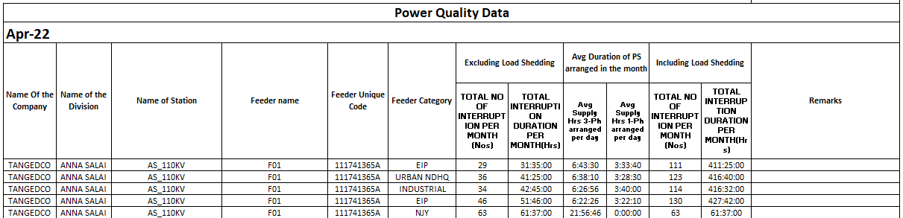

Slide 5
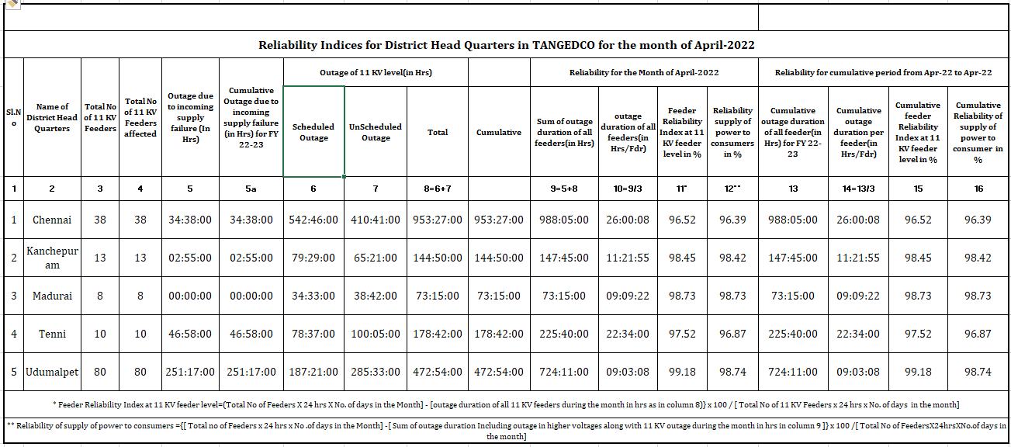

Slide 6
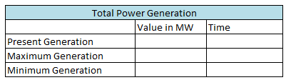
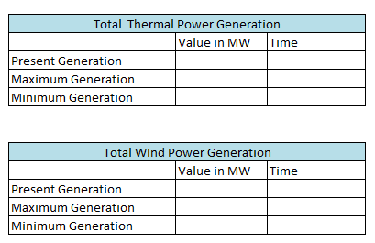
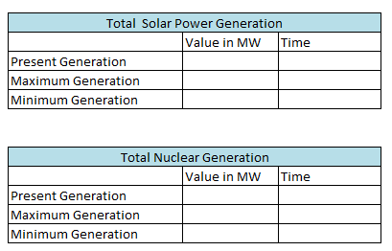

Slide 7
Residential
Domestic Efficient Lighting Program
Ring Back Tune
Multimedia Awareness – Paper, Radio, TV other social medias
Industrial
Solar roof top project
Government Subsidy program
Entrepreneur incentives for solar production / Projects
HUTS
Maturity Index
Agriculture
PM-KUSUM scheme
Installation of standalone solar powered agriculture pumps
Commercials
Incentives for Electric Vehicles
Electric Vehicles charging unit

